Slide 1
Redbridge Homelessness Strategy 2018-23
Voluntary Sector Forum
Wednesday 12 December 2018
Hitesh Tailor
Strategy & Partnerships Officer
T: 020 8708 4978
E: hitesh.tailor@redbridge.gov.uk

Slide 2
Strategy Aims & Priorities
“The council and its partners working collaboratively to prevent and reduce homelessness and to proactively end rough sleeping.”
Priorities
  Ending rough sleeping in Redbridge
  Strengthen our early intervention and prevention services
  Increase the supply of affordable housing to prevent homelessness and to reduce the use of temporary housing
  Support our most vulnerable residents

Slide 3
Key Drivers & Influences
Government Strategies and Legislation
  Homelessness Reduction Act 2017
  Welfare Reform
  Housing and Planning Act 2016
  Social Housing Green Paper (July 2018)
  Rough Sleeper Strategy with aim to end rough sleeping by 2027 + Delivery Plan (published 10/12/18)
Mayor of London Plans:
  Mayor of London’s Draft London Plan
  Draft Housing Strategy (June 2018)
  Mayor’s Affordable Housing Programme
  Rough Sleeping Plan of Action (July 2018)

Slide 4
Local Influences
Financial –
  cost of Temporary accommodation (£34M in 2017/18);
  cost of processing/assessments
Redbridge Policies and Strategies / Initiatives
  Redbridge Housing Strategy – Homelessness Strategy will be in conformity
  Redbridge Corporate Plan
  Redbridge Allocations Policy and Tenancy Strategy
  Housing Register
  Rough Sleeper Protocol / Rough Sleeping Initiative
  Redbridge Together / Project Malachi

Slide 5
Definition of Homelessness
Not all households will be found to be statutorily homeless.
The official definition is :
“A household is legally homeless if, either, they do not have accommodation that they are entitled to occupy, which is accessible and physically available to them or, they have accommodation but it is not reasonable for them to continue to occupy this accommodation. “
Households also need to be in priority need, and that would include families, pregnant women and single people who are particularly vulnerable due to a disability for example.

Slide 6
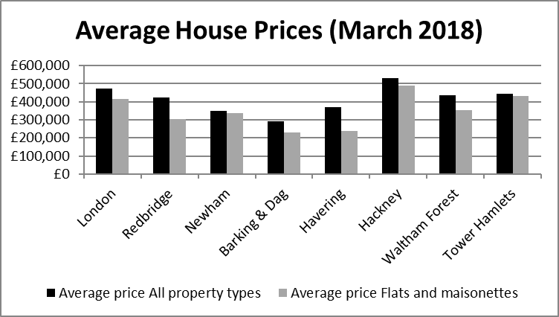
Redbridge Housing Market
The mean average prices for all property types in Redbridge in March 2018 was £422,551, this was a 53% increase on the average prices paid ten years previously

Slide 7
Statutory Homelessness Decisions
Homelessness Prevention and relief – 1754 households were able to remain in their existing home last year through our prevention work. Across London, Redbridge had the third highest figure for the number of successful prevention cases

Slide 8
Key Local Issues
Structural
Use of Temporary Accommodation
Housing Affordability
Housing Supply
Rough Sleeping
Private Rented Sector – affordability and suitability; and standards
Vulnerable Groups
Households in temporary accommodation
Migrant Homelessness
Vulnerable Women
Probation / Ex offenders
Care Leavers
Youth Homeless
LGBT+ Homelessness
Mental Health

Slide 9
Strategy Aims & Priorities
“The council and its partners working collaboratively to prevent and reduce homelessness and to proactively end rough sleeping.”
Priorities
  Ending rough sleeping in Redbridge
  Strengthen our early intervention and prevention services
  Increase the supply of affordable housing to prevent homelessness and to reduce the use of temporary housing
  Support our most vulnerable residents

Slide 10
Proposed Actions
Ending rough sleeping in Redbridge
Build on partnerships – Redbridge Together
Refresh Rough Sleeper Protocol
Project Malachi + new winter shelter
Working with volunteer groups
How can we prevent more people sleeping rough - Work with Institute of Global Homelessness
Regular street count – at least every two years
Strengthen our early intervention and prevention services
Providing quality, timely and accessible information and advice
Supporting people to remain in their homes
Addressing the root causes of homelessness
Tenancy sustainment
Work with private landlords
Improving links to health and employment services

Slide 11
Proposed Actions
Increase the supply of affordable housing to prevent homelessness and to reduce the use of temporary housing
New affordable supply – 1000 new homes by 2022
Providing suitable temporary accommodation
Reducing the amount of TA and greater prevention and discharge
Understand needs of TA residents more
Target for hostel stays – 26 weeks?
Support our most vulnerable residents
Work with probation services to secure accommodation for ex offenders
Work with NASS for resources and equitable approach
Approach to tackling domestic abuse
Lobby Government re NRPF
Secure a pathway for care leavers
LGBT+ Homelessness – understand extent

Slide 12
Next Steps – Respond to consultation
Key Questions:
  Does the Strategy set out the key issues and the right priorities?
  What additional actions could we undertake and who
  What are the equality impacts from delivering these priorities
  What actions could we take to reduce the numbers sleeping rough
Online survey and draft Strategy open till 22 February 2019
https://engagement.redbridge.gov.uk/housing/homelessness-strategy/

