Slide 2
Who we are?
We’ve provided support to victims of crime for over 43 years
In London, we’re funded by the Mayors office
We run the National Homicide Service of Policing & Crime
Support for Major incidences
Children and Young People Service

Slide 3
What we do?
We provide confidential, emotional and practical support and advocacy to victims after a crime, even if it is not reported to the police.

Slide 4
Hate Crime
Hate crime occurs when a person is targeted because of hostility or prejudice towards their/their perceived:
Disability
Race or ethnicity
Religion or belief
Sexual orientation
Transgender identity
Hate crime may be a single incident or ongoing:
Verbal abuse
Physical threats or abuse
Graffiti
Online Abuse
Violence
Robbery
Damage to property
Offensive social media content
Murder

Slide 5
Impact of Hate Crime
Emotional:
Reduced confidence
Lack of self-esteem
Fear
Embarrassment
Helpless
Angry
Vulnerable
Isolated
Shock
Physical/physiological:
Injuries
Inability to sleep
Anxiety
Changes in appetite
Headaches
Nausea
Increased heart rate

Slide 6
Social/behavioural:
Worried to leave home
Fear of it happening again
Change in behaviours
Isolating yourself from friends/family
Using different routes to get to work/go home
Alcohol or drug use
Fight or flight response
Financial:
not able to work, loss of earnings
Lost money due to crime
Additional legal costs
Cost for security measures
Medical costs

Slide 7
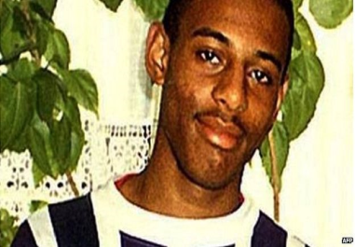
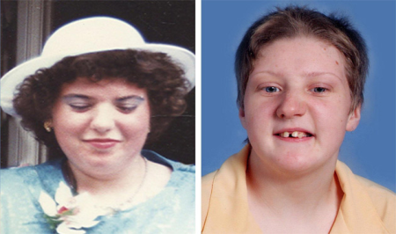
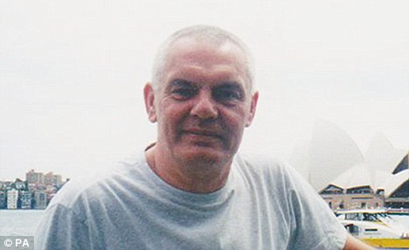
Nationwide incidents
Stephen Lawrence
Fiona Pilkington and Francesca Hardwick
Anti-Semetic and Racist Chanting
Ian Baynham
Notes:
Stephen Lawrence (13 September 1974 – 22 April 1993) was a black British teenager from Plumstead, south east London, who was murdered in a racially motivated attack while waiting for a bus in Well Hall, Eltham on the evening of 22 April 1993.
Ian Baynham 26 Jan 2011 - Ex-public schoolgirl screamed 'fucking faggots' and kicked the unconscious Baynham in fatal Trafalgar Square assault
Fiona Pilkington killed herself and her severely disabled daughter Francecca Hardwick in 2007, after 10 years of torment by local youths.
Football chants:
15/12/2018 It comes after Chelsea condemned a vocal minority of their fans for anti-Semitic chants during 2-2 draw with MOL Vidi in Hungary.
27/01/2019 Millwall face Football Association punishment for racist chanting during the FA Cup victory over Everton, and the club promise to ban for life anybody found guilty.

Slide 8
Lack of Access
Education
Cultural barriers
Fear of reprisals
Disengagement and lack of trust with Police/CJS
Language
Stigma
Unawareness
Historical trauma and normalised to abuse
Barriers to Reporting Hate Crime

Slide 9
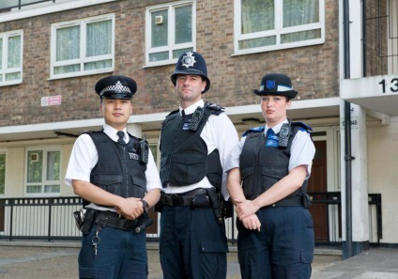
Reporting Hate Crime
Police – 999 in an emergency
Police non emergency -101
Crimestoppers – 0800 555 111
True vision – Online reporting form
Stop hate UK – 08001381625 (24 hour help line)
Victim support – 08081689111
CATCH (Community Alliance To Combat Hate – Online reporting form

Slide 10
Hate Crime support in Redbridge
Our current Victim Support Redbridge team focus on:
Supporting victims of hate crime, emotionally and practically
Community engagement to raise awareness of all types of hate crime
Working with other agencies
Delivering awareness raising sessions to professionals and marginalised communities
Being a voice for victims in multi-agency meetings
Signposting where necessary
Our specially trained volunteers can:
Help you cope with the emotional effects
Support you and other members of your family
Help you get in touch with other organisations
Give you information on personal safety and home security
Organise practical help, such as repair broken locks
Attend the police station or support you in the court process
Provide information on the Criminal Justice System
Work towards reducing repeat victimisation

Slide 11
Contact details
Local office in Maritime House
Telephone: 0203 910 9040
www.victimsupport.org.uk
Victim Support line: 0808 168 9291 (free phone)

