Slide 1
Redbridge Voluntary and Community Sector Consultation Summary of findings and recommendations
Caroline Masundire
Associate Director
June 2018

Slide 2
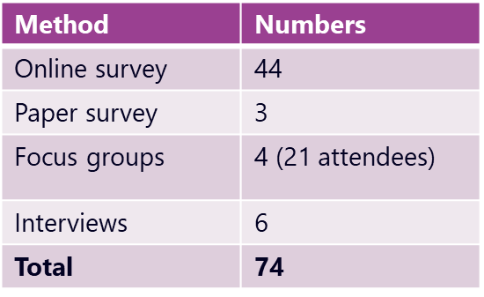
Introduction
Consultation took place early summer, report in June
Important context: Civil Society Strategy, Mayoral response to Philanthropy Review
Reflections from work in other places: Camden, Harrow, Hounslow, Waltham Forest, Southwark, Richmond

Slide 3
Profile and need

Slide 4
Summary
Although the survey response was lower than expected, the profile of organisations who have responded appear broadly similar to the make up of the sector in the borough described by stakeholders, ie predominantly small organisations, who have been operating for a long time.
Organisations are offering a wide range of services and working with a diverse range of groups and needs across the borough, in the main at least fortnightly.
Residents needs are varied. Services are predominantly focused on providing advice and support around health and wellbeing, housing and poverty issues, activities to help reduce isolation, improve access to services/education and support community cohesion.
Organisations are expressing concern about resourcing of services from reduced statutory funding for them to manage demand as well as other factors which impact on raising demand for services such as housing, increased poverty and transient populations.

Slide 5
Who responded to the survey?
Almost all of the surveyed organisations are well established, with only one organisation having been set up in the last year. Three in five have been running for over 20 years.
The majority are also registered as a charity, with 11 designated as a CIO, charitable company or CIC.

Slide 6
Where do they operate?
Most organisations work either in or across Redbridge with just under 40% stating that they worked across East London. Unsurprisingly smaller (<£10k income) organisations are more likely to work solely in Redbridge.
Where organisations operate
Percentage of organisations

Slide 7
Income and funding

Slide 8
Summary
There are mixed opinions about future income potential, with younger and smaller organisations feeling more optimistic than old organisations.
Clear appreciation of the funding environment but expectation that the council needs to be clear about what it can and cannot fund/support.
Recognition of the impact of reduced/increased funding on local residents, but that organisations have little time/capacity to respond and plan for the future.
Reliance on and expectation of volunteers is high to run services, but access to and recruitment of volunteers and trustees is increasingly difficult (average 10-30 volunteers needed)
Although representing less than one third of income donations individual giving is a common source of funding across all organisations, with contracting and crowdfunding the least. Those contracted by the council stated their concerns about impact on services if these contracts were lost.
Organisations are relying on a mix of income, with only four reliant on local or national government grants.

Slide 9
What is the annual income of respondents?

Slide 10
Optimism about future income
45% of respondents feel their income will increase in the next three years. 26% feel there will be no change in their income, whilst only 10% expect a decrease.

Slide 11
Findings from our conversations
Although organisations recognise that cuts in funding and trying to do more with less was inevitable, the optimism about the future was not shared among focus group attendees.
There is an expectation that the council has a role to play in supporting the sector but with less resource, organisations are worried about their own future and that of their beneficiaries.
Organisations want the Council to be honest and upfront about what it can do to fund/support the voluntary sector as needs are changing.
Organisations that rely on grants and contracts from the Council feel like they have limited ability to plan strategically for the future when funding is unknown.
Organisations also rely heavily on volunteers both for delivering services and to support their governance, but are finding the recruitment of volunteers harder than ever. There are greater barriers, not least availability of volunteers, but also unrealistic expectations of those volunteers
Organisations are worried about the time they have to both deliver services and secure funding. They are working beyond capacity “trying to do five jobs in one” which is contributing to uncertainty and their own ability to plan effectively for the future.
There is concern about the viability of contracts and despite being stable now some organisations are facing a financial shortfall in the future “We have a 10 year lease…5 years into that our rent is going to be doubled – we’ve got a challenge to meet that”
“It’s the time factor –It’s also a capacity thing as people now a days don’t have much time on their hands – now looking at volunteers who are retiring but normally it used to be a much wider group that you could harness into – physical capability – can’t be sustained with the volume of work”
“We’re seeing the support needs changing and people with lesser support aren’t getting the services they need and that has a knock on effect to the funding of our projects – we need reassurance and a plan and we would like to know where things are heading – and that people are working with us”

Slide 12
Access to and use of space

Slide 13
Summary
Most VCS organisations are renting space, and more than 50% find hiring space in the borough difficult.
50% of respondents either rent from the council or from another charity - only 2 organisations own their premises.
10% of those that rent from the council receive a subsidy.
Respondents to the survey feel that quality of space and state of repair is poor and they would need to invest in the space or move to deliver better services to residents.
However those commenting on space during interviews and focus groups were happy with the current offer suggesting (unsurprisingly) that the sector is diverse and organisations have differing needs and experiences from one another.

Slide 14
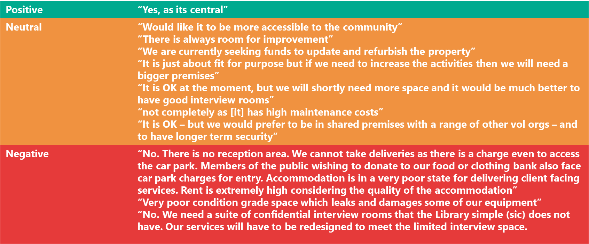
What is the quality of space in Redbridge?
The fifteen respondents who commented on their rented space were ambivalent to negative about its fitness for their purposes.
Most of the comments relate to the quality and state of repair of the space as well as the limitations this has on their ability to provide or increase services to residents.

Slide 15
Partnership and collaboration

Slide 16
Summary
Although those organisations that have a relationship with the council generally report that this is good, the quality of partnership working with the council is rated low (similar to businesses).
However, organisations feel that there is greater potential for improving partnership working with both the council and Redbridge CVS. They also see further potential for working with businesses.
Organisations are collaborating with each other but mainly on an informal basis and to support the needs of their clients. Some share resources and space and see the benefits of doing so, not least in providing joined up services.
However more formal collaborations are scarce, indicating a potential challenge for commissioners in using formal partnership models (ie lead partner) in contracting. Commissioners may need to do more work if they want to bring greater diversity/options to their supplier base.
Organisations report that they are very stretched and making time to build relationships with others and to collaborate is hard to do. They tend to work with and build on relationships with people they know rather than work on new relationships. This could be a missed opportunity for greater collaboration and partnership working.

Slide 17
Respondents’ relationship to the council
Just over one third of respondents do not have a relationship with the council. For those that do, most report that this is a good relationship.

Slide 18
Potential for future partnership work
Organisations see potential for greater partnership working, particularly for the CVS, the council, other statutory organisations and businesses.

Slide 19
How do organisations collaborate with each other?
Organisations are most likely to network informally, make referrals or join forces when needed and share resources and space. They are least likely to do more formal collaboration around joint bids/contracts or consider mergers.
This suggests that collaboration is happening in the borough but not at the level or type that the council or other commissioners/funders might expect. This does present a challenge for how the council and other agencies commission the sector, being aware that the lead provider model might not be appropriate or achievable for some services/organisations.

Slide 20
Findings from our conversations (1)
There was a general view from consultees that the Council is only working with charities so that they can deliver services at a drastically reduced cost. Voluntary organisations felt that the council should create a framework to deliver services that was based on co-production and co-design, with the sector and residents.
There was also a degree of frustration that the council has done a lot of consultation but that this has not led to further action. Maintaining relationships with the council is challenging not least because of the time and effort needed by organisations to sustain them.
Although organisations recognised that lack of funding and cutting costs is the greatest issue facing the council they felt that conversations now need to move on to finding alternative solutions.
“There was a time when charities worked in partnership with the council and they had an interest in what charities were doing and they had joint work with us and now it feels like that is disappearing”
“About a year ago the Council were really good and managed to sit down with a few councillors and officers to get their opinions but now tried to get back in touch with them and you lose touch – and trying to re-establish that is quite hard and trying to maintain that relationship is hard”
“We need action – we’ve engaged and now the council need to engage back with us – we want to know what the next steps are – now it’s about communication – it’s about the council coming out to talk to us and showing their learning – how do they plan to address/an answer for it – especially beyond we have no money.“

Slide 21
Findings from our conversations (2)
In our conversations voluntary organisations expressed the view that, in general, the Council had maintained poor relationships with the sector, although those centres supported by the council were more positive about their relationship
There were piecemeal examples of collaboration, but a sense that there was no guidance or strategic oversight. Successful partnership working was felt to be disproportionately related to the strength of personal relationships.
Developing relationships with other groups takes time – this was raised as one of the obvious, but important barriers to why collaboration does not happen as often as it should. Many of the community centres interviewed were sceptical about the possibility of effective collaboration with the private sector –some felt they were in direct competition.
There was also a feeling that the business sector in Redbridge was too small to make collaboration particularly useful or transformative.
People did feel that were opportunities to work with business but that this needed to be better facilitated.
“Collaboration is really about who you know – you wouldn’t naturally go to the council – they have walls that you just can’t get through – you have to try and find what’s going on in your area and link in somehow”
“We think about collaborating with businesses but the businesses here are small – no one has a CSR budget – we talk to the BID and the chamber of commerce – but they operate like small charities – but they don’t have any money – we’ve done bits of work to get paid staff to mentor volunteers, but we haven’t been able to sustain that “
“{our}.. partnership with x centre….came about with me contacting {them}and arranging a hamper drive – and just a discussion about what we could do to help and what they could do .…..it’s knowing who to contact”

Slide 22
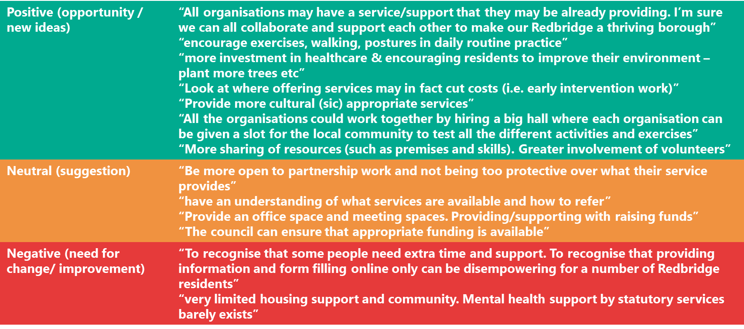
What could be done to improve partnership and collaboration?
While we have seen positive examples of organisations working together, many felt that more could be done to improve connections and partnerships between them. Others had specific suggestions for things that the Council could do, such as providing “premises for fundraising events” or other resources.

Slide 23
Support needs

Slide 24
Summary
The four highest rated support needs for the sector are developing sustainable income streams, volunteer management, fundraising from business and marketing and promotion.
Organisations see the council and Redbridge CVS as key sources of support but also rely on their own networks to access information and help.
Less than 10% like to receive support purely online with the majority wanting a mix of interactions - ideally face to face/one to one.
The sector’s view on the quality of its relationship with the council is poor, but thinks there is good potential for this to improve.
Main themes for support from conversations include improving access to volunteers/trustees, support for local businesses, council communications and relationships.

Slide 25
Where do organisations go for support?

Slide 26
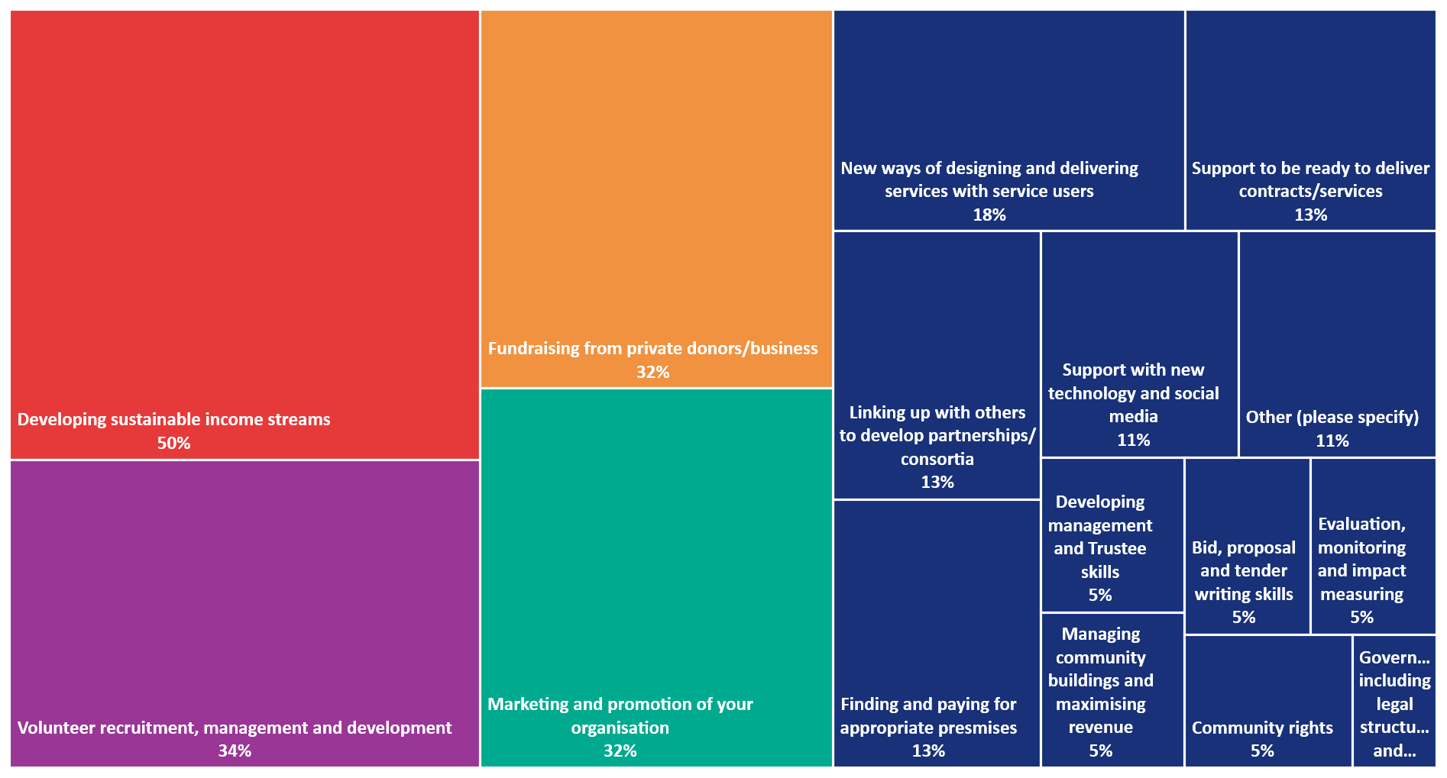
Top support needs of the VCS

Slide 27
Priority need 1 - Trustees and volunteers
The attendees at the focus groups felt that recruiting for volunteers and trustees was increasingly difficult. Voluntary organisations believed that the increasing ‘professionalisation’ of volunteering and thus the additional time needed for training and managing, coupled with the decreasing amount of free time amongst the population had an adverse effect on volunteer and trustee recruitment.
Another main reason for the reduction of volunteers was a perceived sense of a loss of community memory. Many respondents noted that volunteers would traditionally come from local communities, and would often be either current or previous beneficiaries.
However, the increasing cost of living across Redbridge, and the trend for people to move out of the borough, meant that the traditional routes to engaging with volunteers, particularly trustees, were less effective.
There was consensus among the most of the attendees that the council could do more to promote and champion the benefits of volunteering and the opportunities in the borough.
.
“Yes we tried for 3 years to recruit more trustees and we just didn’t get anywhere.”
“A lot of people have increased limits on their time and charities have a lot of difficulties in getting volunteers. We require a minimum of 5 hours a week and we struggle to get volunteers through the training and struggle to get people to do the fundraising as well”
“We’ve found it very hard to recruit new trustees as we try and get trustees from members of the club and now they have moved away from Ilford”
“There is the volunteer service that is part of the CVS service and they’ll help people who are interested in volunteering and charities who want volunteers and they try and broker a match but it’s not always easy”

Slide 28
Priority need 2 – Work with businesses
Attendees of the focus groups were negative about their current work with businesses, because of the size and nature of the sector. However raising income from businesses was the fourth highest rated support need in the survey.
Many people told us that the majority of businesses in Redbridge were small and often had similar capacity and resource issues as voluntary organisations. They were also hard to engage with. Often good relationships form when the organisation and business share a common area of interest, ie particular group or place.
What is important is that businesses are able to share the vision of the organisation and work in a more sustainable way:
Some attendees stated that they felt they had and could develop better relationships with business outside Redbridge, particularly those that operated across a wider area.
But unsurprisingly all said that relationships were built on the quality of engagement both of the voluntary organisation and business staff and the time it takes to develop them.
One of the main areas of support from business could be to address trustee shortages particularly considering there are many small professional firms and these could make a big difference around financial management and governance.
“With businesses it depends often on the staff, our part time coordinator is excellent like that where local restaurants/shops will give services/donations etc. but again it takes time and skills”
“One of the things I’d hope is that business would want to buy into our vision – we’re trying to do good in the community and hope they would come and try and see and engage with that first”
“We are short of trustees and it’s difficult and we would like to engage with businesses – lots of accountancy firms and get some of those people to volunteer as treasurers etc.”

Slide 29
Priority need 3 – Relationship reboot?
The VCS has high expectations of the council and although considers the quality of its relationship as being relatively poor, it is optimistic that it could improve. VCSOs are also likely to approach the council for support as well or instead of Redbridge CVS, which means that there is likely to be a need for clarity on the role and expectations of the council compared to the CVS.
The impression of the Council from VCS organisations attending the focus groups was one of a ‘closed doors’ environment. There was general consensus that it was increasingly difficult, and frustrating, for organisations to find council officers to talk to and who had sufficient knowledge to deal with the query. This was an issue not just about organisational support, but also around how better to provide support and advice to beneficiaries. Redbridge Council’s website was repeatedly mentioned as being unhelpful.
Many organisations felt that they were not supported when they did reach out to the council and were passed around services which did not have access to all the information needed.
There are clearly various levels of engagement needed between the sector and council but a good starting point would be around improved access to universal information.
What is clear from the consultation is that the VCS has a shared commitment with the council to supporting the wide range of resident needs. So there also needs to be clarity on the council’s expectations. Organisations are aware that funding is tight and reducing so this engagement needs to move beyond what could be considered a transactional relationship to one of co-designing solutions to address the needs of the borough.
“The Redbridge website is diabolical and finding information is hard”
“Simplicity of website is essential – you can’t find contact details”

Slide 30
Conclusions and ideas

Slide 31
Conclusions
This consultation has provided helpful but possibly unsurprising insight into the views and needs of the Redbridge’s Voluntary and Community Sector.
Based on our findings the sector is, as expected, diverse and serving a wide range of needs across the borough. Although with predominantly small levels of income, there is optimism for the future and a willingness to engage and work with the council and other partners to meet the needs of residents.
Levels of collaboration are high and this is seen to be critical to deliver services, share resources and work in the best interests of service users. Although this collaboration is not formalised and likely to be difficult for commissioners like the council to engage with through its contracting and grant-making arrangements.
There are concerns about the current engagement the council has with the sector. The sector is aware of the financial constraints the council faces, but wants to have a more informed and meaningful relationship with the council based on honesty and trust. It also wants to work with the council to focus on earlier intervention and prevention and have improved relationships and access to information to key staff and services.
Improving access to and recruitment of volunteers and trustees is a key need for the sector as is building better relationships with business to support fundraising and access to resources.
Additional support is needed to help organisations develop sustainable income streams as well as improving their marketing and promotional skills.
Finally, access to suitable and quality space both to deliver services from and to hire is a key need for groups. Community centres are important sources of space, information and support. The council could make better use of this resource and other intermediaries ie Redbridge CVS.

Slide 32
Some ideas
Issue | Recommendation
Doing business with the sector What can council do/cannot do to support the sector in the current environment What expectation does it have ie if service delivery then how can it fund or support services Who does it want/not want to engage with | Cold hard look at what is the potential/opportunity and develop shared understanding with members, departments and staff Then consider the development/update of a Compact/SLA with sector – using a co-designed approach based on common understanding between council and sector
Communication with the sector Confusion about who and how to contact Expectation of sector on council to engage Role of intermediaries ie CVS | Development of simple VCS portal within the council website with key sources of information, contacts and links (internal and external) to support Appoint VCS lead/champion in each department as point of contact for information/follow up Use compact/SLA to communicate relationship and role between council, strategic partners and sector Consider an annual celebration/networking event to bring sector together (possibly linked to a campaign around local volunteering/social action)
Enabling the sector/Unlocking local and other assets/funding Helping the sector to fundraise/access resources more efficiently Create greater and better links with businesses Access to better premises/space | Review Redbridge Giving Scheme with a focus on improving giving from business and sourcing support from other local and trust funders (CCG etc) Consider using levers such as business rate relief for business offering free or peppercorn space to VCS organisations Work with other statutory and trust funders to encourage investment and funding into the borough

